Slide 1
TEAM Spark
Detect Medical Emergency on Wheels

Slide 2





Team
Spark

Slide 3
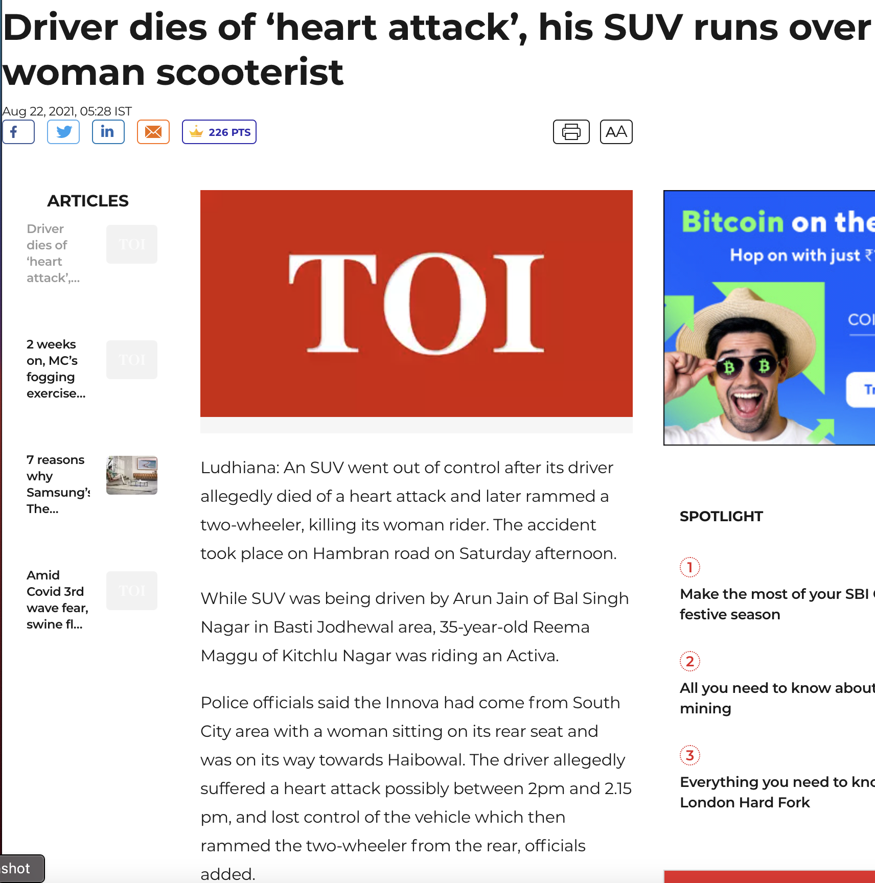
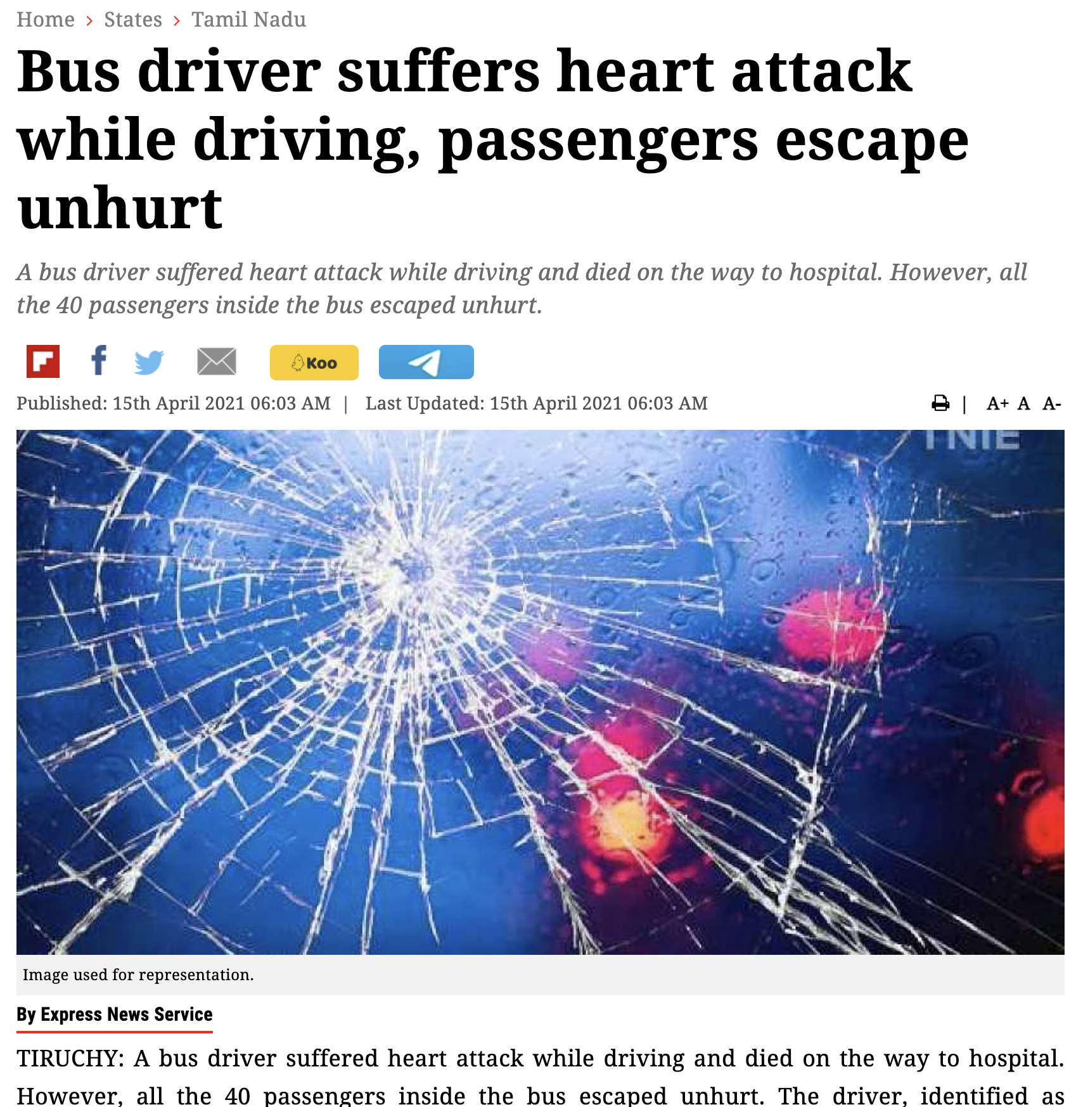
Objective: Detect Medical Emergency on Wheels
Source: https://www.newindianexpress.com/states/tamil-nadu/2021/apr/15/bus-driver-suffers-heart-attack-while-driving-passengers-escape-unhurt-2290119.html
Source : https://timesofindia.indiatimes.com/city/ludhiana/driver-dies-of-heart-attack-his-suv-runs-over-woman-scooterist/articleshow/85525575.cms

Slide 4
Statistics : Medical Emergency while driving
Medical condition | Estimated %
Seizure | 35 %
Black out | 29 %
Diabetic reaction | 20 %
Heart attack | 11 %
Stroke | 3 %
Other | 4 %
Driver’s injury Severity | % of drivers with medical emergency | % of drivers without medical emergency
No injury | 14 % | 49 %
Possible injury | 24 % | 22 %
Non-incapacitating injury | 27 % | 14 %
Incapacitating injury | 24 % | 10 %
Killed | 4 % | 1 %
Severity unknown/unknown if injured | 7 % | 4 %
Driver’s Pre-Impact location on trafficway | % of drivers with medical emergency | % of drivers without medical emergency
Stayed in original lane | 14 % | 72 %
Stayed on road but left original lane | 17 % | 9 %
Departed road, road runoff | 69 % | 17 %
Other/Unknown | 1 % | 2 %
Hanna, R. (2009). The contribution of medical conditions to passenger vehicle crashes (No. HS-811 219)

Slide 5
Plan of Action
Following are the few indicators that can be observed for at the time of Emergency
Effects (CAN data):
No or very low steering correction for long time
Large amplitude steering-wheel moment
Visual cues (In-Cabin):
Eye Closure for long time
Head Down / Up
Observing any pain from the facial expression
Hand grip on steering wheel
Visual cues (Dash Cam):
Irregular freq of lane change for a give time interval
Physiological cues(Heart rate):
Heart rate

Slide 6
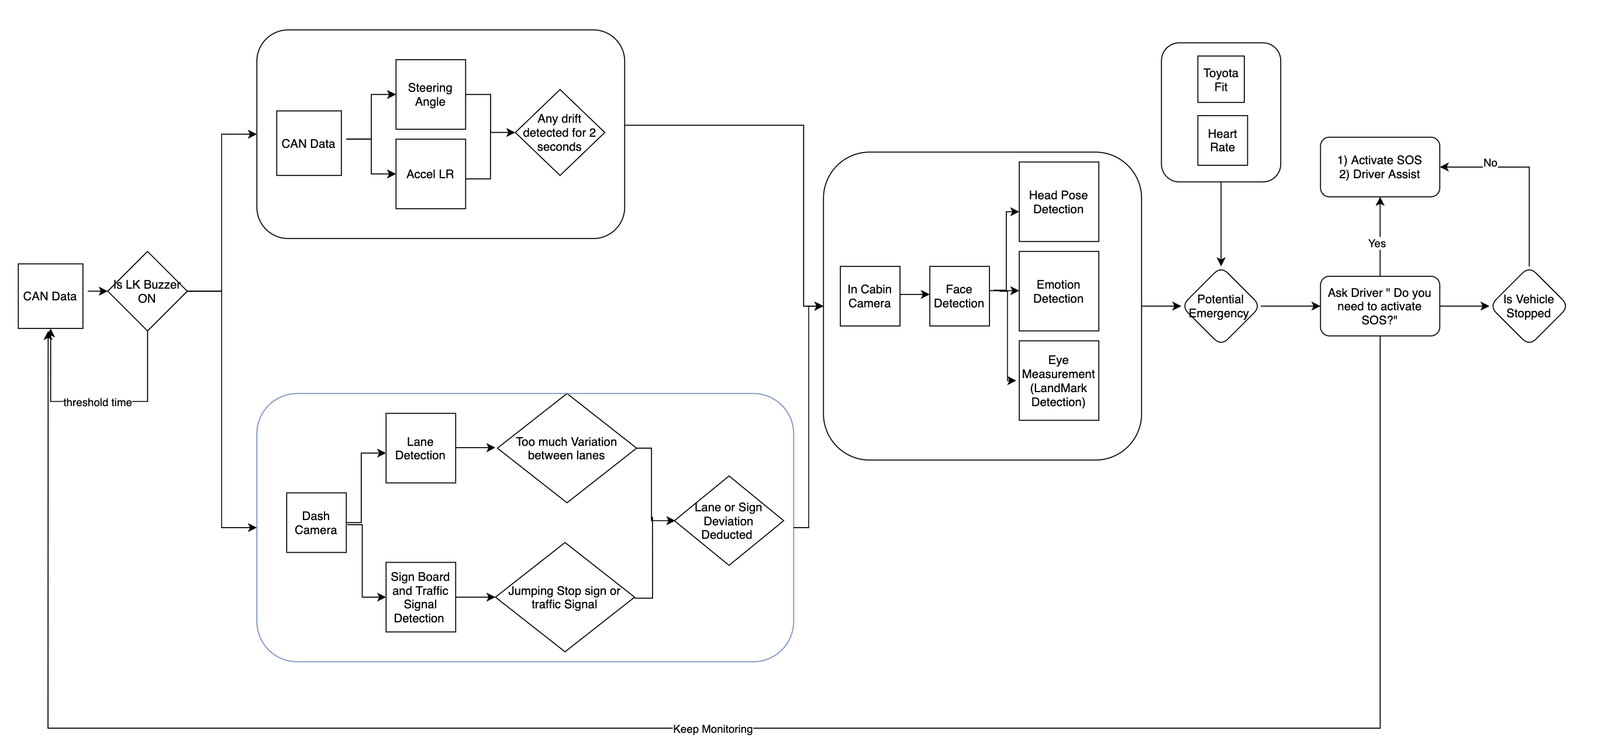
Overall Architecture

Slide 7
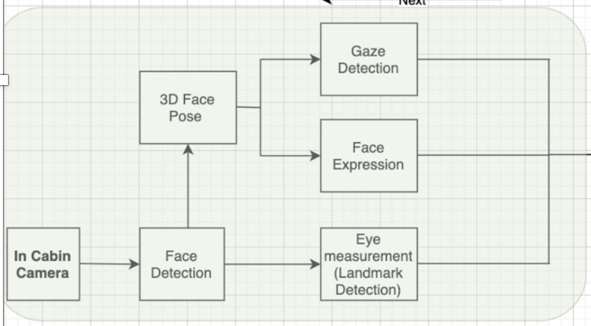
In-Cabin Data
Eye measurement:
Observe for blink time increase or slow blink or no blink (complete closure of eyes)
Eye Ball movement
Head Pose:
Monitor head position either it is continuously down or up
No change in head movement
Expression:
Look for signs of Stress/Anger/Pain from facial expression
No of occupancy:
Look for occupancy , single occupancy is given more priority for this model

Slide 8
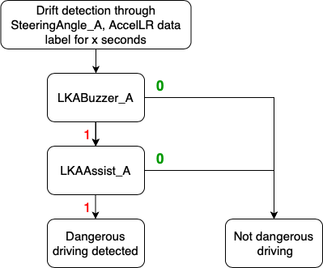
CAN Data
CAN data cannot be a standalone source to detect Dangerous or reckless driving , It needs to be paired with Dash Cam footage to ensure drifting

Slide 9
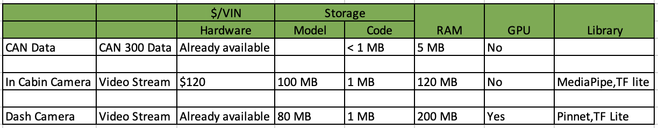
Edge Device and Cost Break down
The SA8155P Snapdragon processor includes eight Kryo™ CPUs, a Qualcomm® Adreno™ 640 GPU and high-performance Hexagon™ 6 DSP. The ADP features rich connectivity through Wi-Fi 802.11ax, Bluetooth LE 5.1. The ADP supports up to 8 GMSL cameras and 5 mini display ports.

Slide 10
Demo - In Cabin Camera

Slide 11
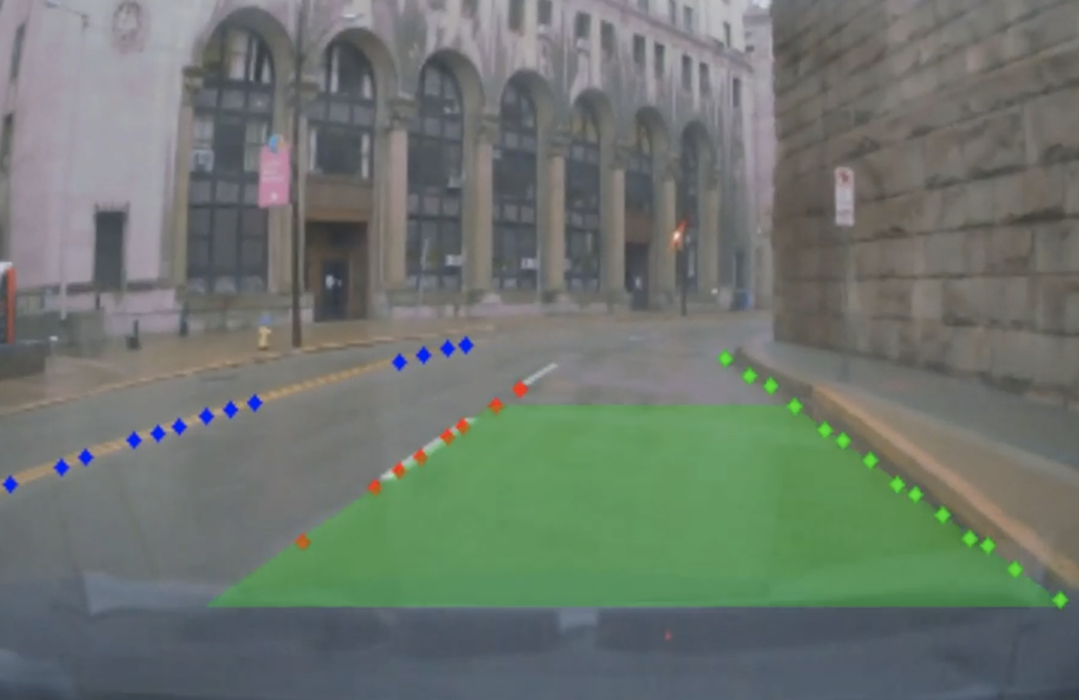
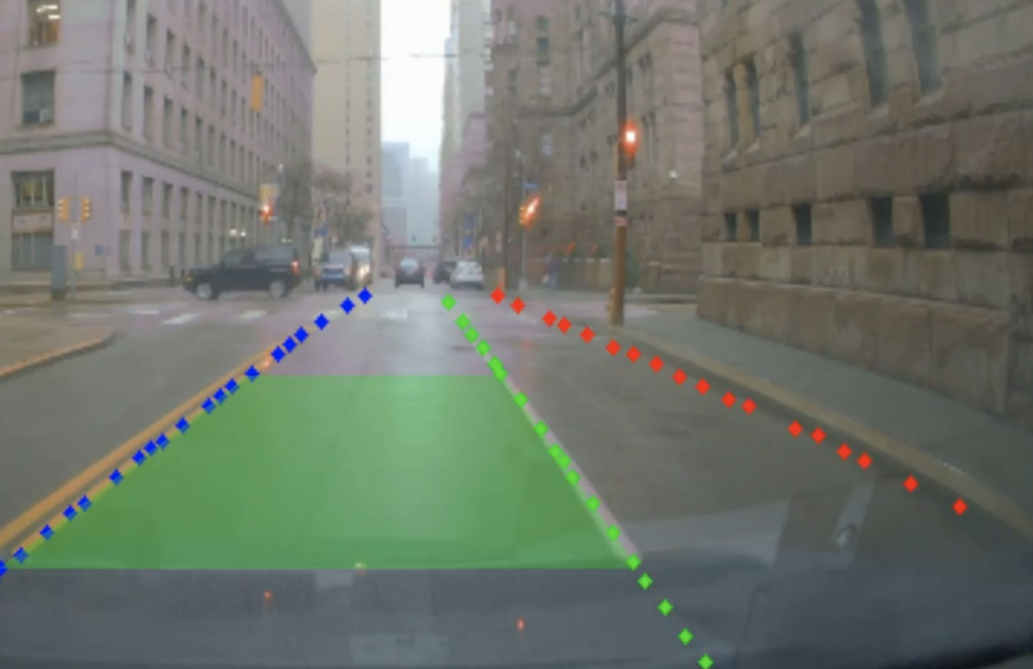
Dash Camera – Lane Change – Sample Screenshots

Slide 12
Next Steps
Seizure, stroke, erratic breathing, grunts(involuntary human noise) detection through voice samples for determination of emergency type. This would enable first responders to be better prepared to help the individual at risk.

Slide 14
Thank you!

